Slide 1


MED-Assist
Team Bazinga!
Augmented and Virtual Reality (AR - VR – XR)
the Frontier of ADVANCED TECHNOLOGY IN Health Care

Slide 2
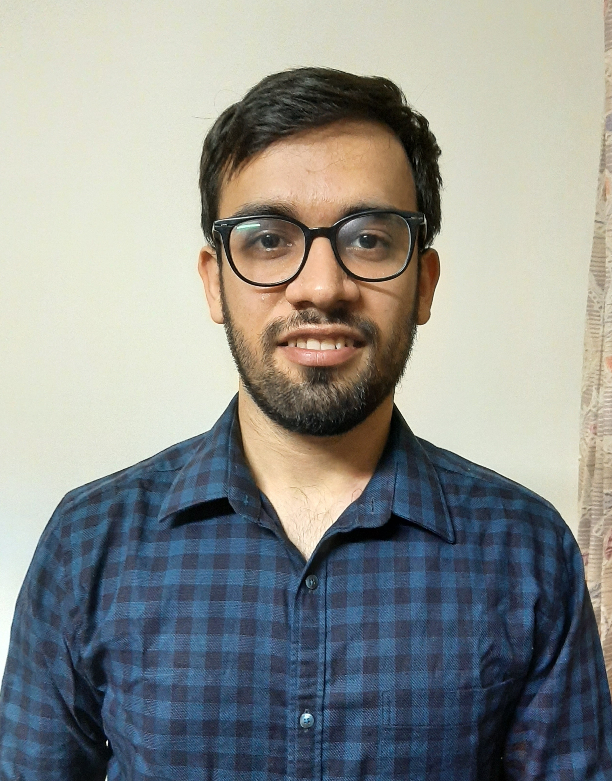


Team Member Profiles
Pic
Pic
Pic
Navneet Sharma
Product Engineering, Bangalore
Neha Pahuja
Product Engineering, Bangalore
Arpit Batra
Product Engineering, Bangalore

Slide 3
Overview
Traditional Process
Type Complicated names of different Medicine/Device
Scroll through various websites to get required info
Verify the authenticity of the visited webpage
With Our Solution
Open the app
Capture the Device/Medicine
Get quick results

Slide 4
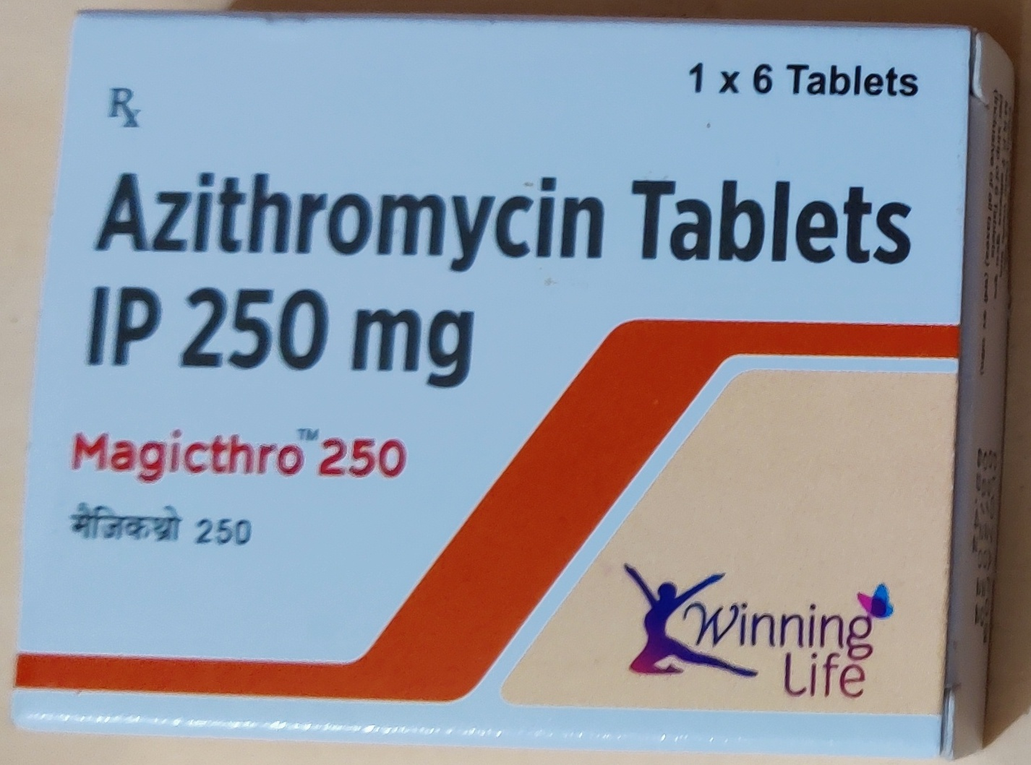
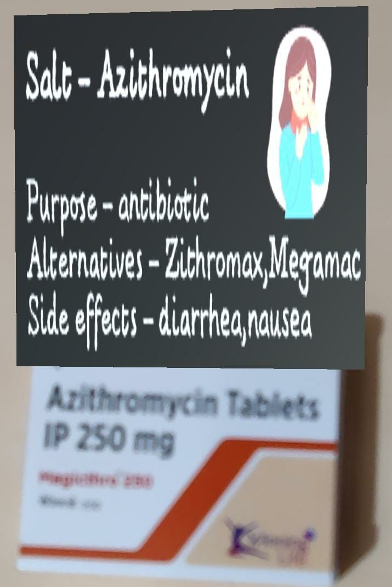
How it works
Camera Feed
Pixel Format Conversion
Feature Extraction
Extracted Features
Cloud Database Target Images
Feature Matching and Tracking
Output Feed
Render Camera View
Superimposing Info Cards

Slide 5
Solution Synopsis
Describe Your process or method e.g. Computer Software and Method of Doing Business. An android app which makes use of Augmented reality to make people aware of medicines and covid-19 treatment .
What is Useful, Novel, Non-Obvious ABOUT Your Solution?
Gone are the days of searching for medicines on different websites trying to gather some info. Ours is a lazy solution where user just has to open the app and place the medicine in front to get all the info in gist.
WHAT IS UNIQUE ABOUT YOUR SOLUTION, AND WHAT MAKES IT DIFFERENT?
It is a one-stop solution to get details about any healthcare related equipment or medicines in Augmented Reality. Currently no market application exists taking use of AR for medicines and healthcare equipment for the common user.
How does it work?
We have an image database of medicines and equipment stored in Vuforia. Correspondingly we have mapped data columns such as side effects, alternatives, etc. to this data. When the app is on the camera tries to recognize objects from the DB and if detected, shows the relevant information on top of the object like a placard.
What value is delivered by your solution?
It is a quick and fun solution to learn about medicines and how to use healthcare equipment just by using this simple application.

Slide 6
DEMO

